Slide 1

Groovy Maven Builds
Evgeny Goldin
Thomson Reuters
@evgeny_goldin

Slide 2
Evgeny Goldin
Software Developer – 12 years
Dev : C++ => Perl => Java => Groovy / Scala
CM : Ant => Maven => Gradle
OS : Artifactory, TeamCity, Jenkins
Write for GroovyMag and Methods & Tools
Maven plugins, GCommons library

Slide 3
Maven state of affairs:
Maven is rarely used to its fullest potential
“maven-antrun-plugin” is overused
No community around plugins
  http://maven.apache.org/plugins
  http://mojo.codehaus.org/plugins.html

Slide 4
About this session:
Maven can be made better!
.. especially when you use Groovy
We’ll see how:
  GMaven
  Polyglot Maven
  Groovy MOJOs + Demo

Slide 5
Maven and Gradle

Slide 6

Gradle - dynamic build applications.
Maven - repeatable build processes.

Slide 7
Maven makes it awkward to ..
“if” a model composition / plugin execution
Specify dynamic value when configuring a plugin
Put your own logic in POM
Modify existing plugins behavior
Pass in-memory information between plugins

Slide 8

Is the game over?
Or can builds become applications?

Slide 9
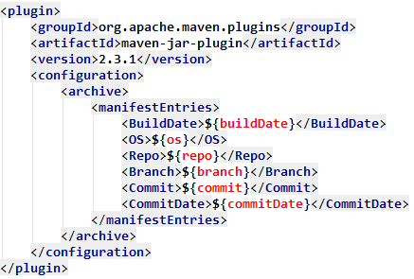
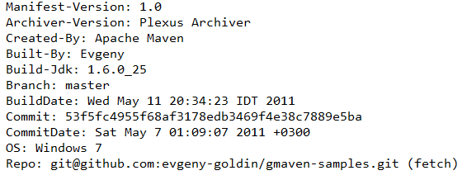
Use case – Build Metadata

Slide 10
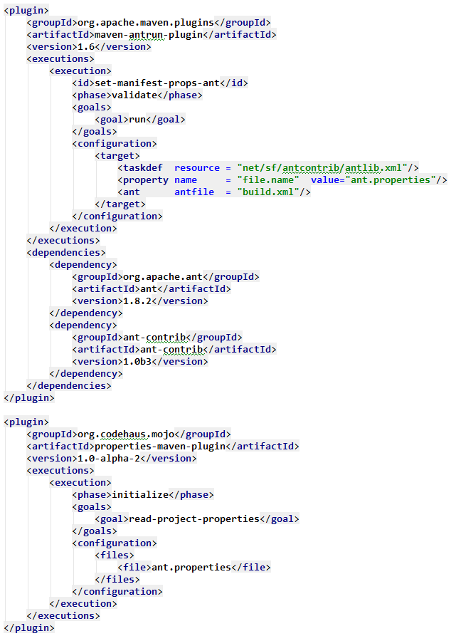
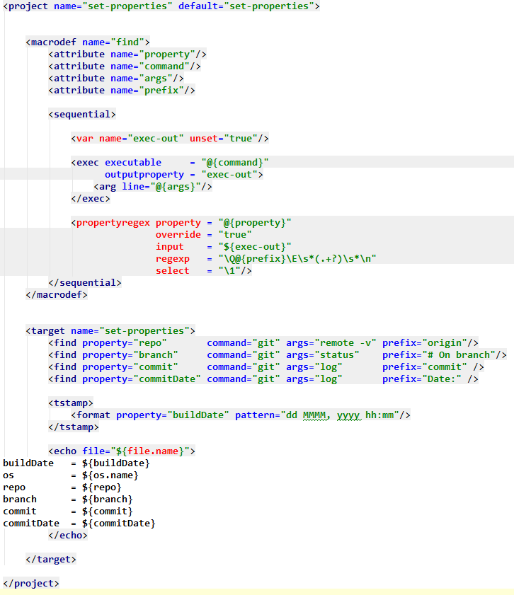
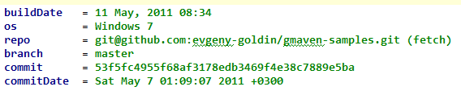
Ant:
~60 LOC
(100 total)
3 files
http://goo.gl/i0ldH

Slide 11
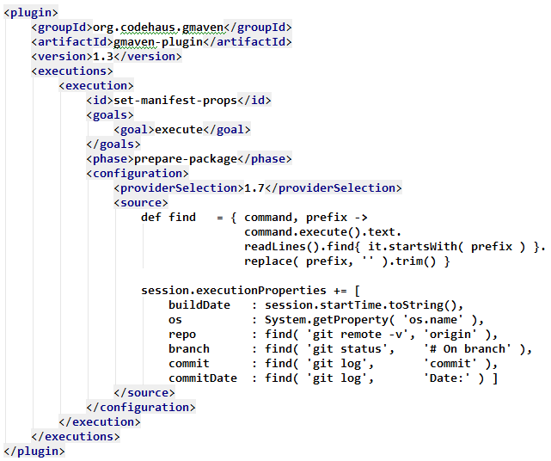
Groovy: ~10 LOC (30 total)
http://goo.gl/GdS6y

Slide 12

Compiles Groovy code
Executes Groovy code
Generates Java Stubs, required for MOJOs
Join Compilation with Java (sort of)
http://pinboard.in/u:evgenyg/t:gmaven/

Slide 13
<goal>execute</goal>
Runs Groovy code
Runs Groovy script
Runs Groovy class

Slide 14
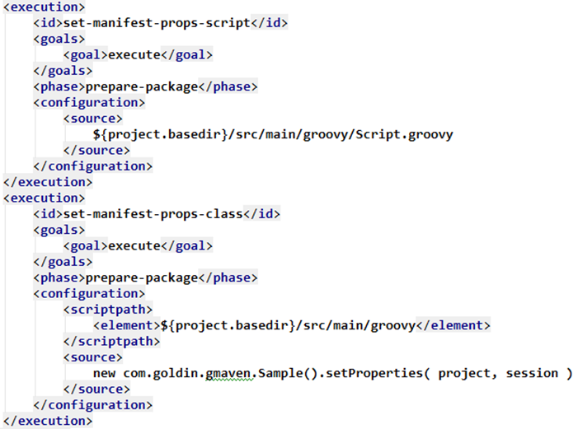
Get IDE support back!
http://goo.gl/8DOe2

Slide 15
<goal>execute</goal>
Runs Groovy code
Runs Groovy script
Runs Groovy class
MavenProject
MavenSession
Maven’s “ServletContext”

Slide 16
MavenProject – Static Info
http://goo.gl/3Ve31
Coordinates
Properties
Artifacts
Dependencies
Basedir
Remote repositories

Slide 17
MavenSession – Runtime Info
http://goo.gl/Kh8iL
Current MavenProject
Build start time
User properties
System properties
Goals
Local repository

Slide 18
GMaven
“if” a model composition / plugin execution
Specify dynamic value when configuring a plugin
Put your own logic in POM
Modify existing plugins behavior
Pass in-memory information between plugins

Slide 19
Use case – Build Metadata

Slide 20
http://evgeny-goldin.com/wiki/Maven-about-plugin
<plugin>
<groupId>com.goldin.plugins</groupId>
<artifactId>maven-about-plugin</artifactId>
<version>0.2.3.4-about-fix</version>
</plugin>

Slide 21
http://evgeny-goldin.com/wiki/Gradle-about-plugin
apply plugin: 'about‘
...
about { dumpDependencies = true }
...
assemble.doLast { about.execute() }

Slide 22
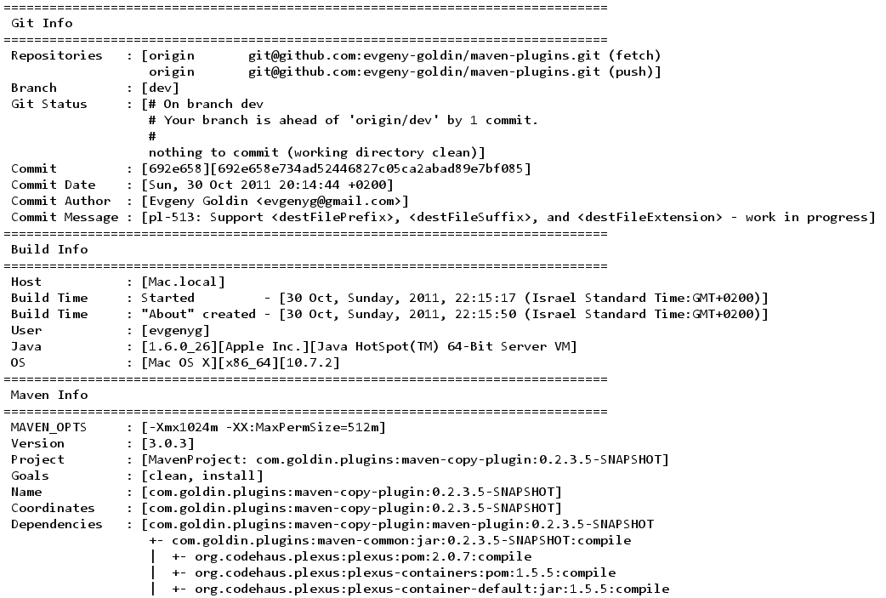
something.jar/META-INF/about.txt

Slide 23
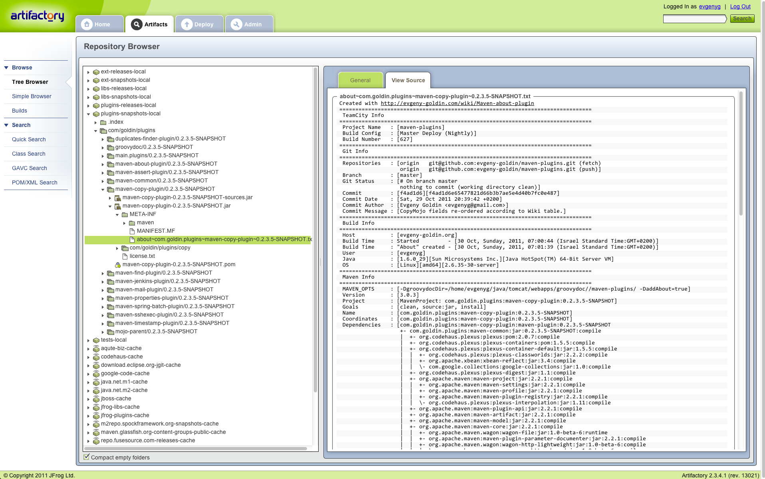

Slide 24
?

Slide 25
Polyglot Maven
https://docs.sonatype.org/display/PMAVEN/
https://github.com/sonatype/polyglot-maven
git clone + mvn clean install
translate pom.xml pom.groovy

Slide 26
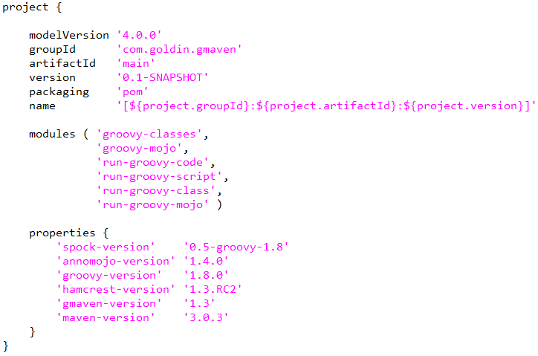
http://goo.gl/U5eqr

Slide 27
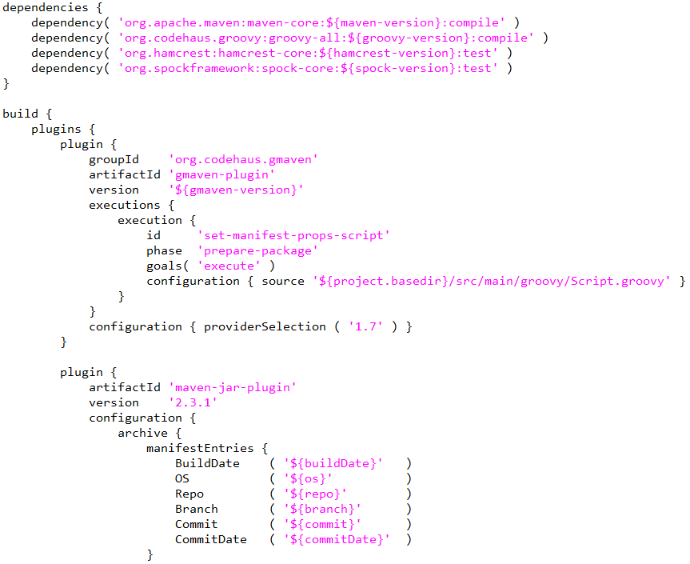
http://goo.gl/av0Dx

Slide 28
Polyglot Maven
Groovy syntactic sugar to Maven POM
Couldn’t find a way to
  Attach a code to a lifecycle
  Locate MavenProject and MavenSession

Slide 29
Polyglot Maven
“if” a model composition / plugin execution
Specify dynamic value when configuring a plugin
Put your own logic in POM
“validate” phase

Slide 30
Groovy MOJOs
Reusable
More exposure to Maven runtime environment
http://pinboard.in/u:evgenyg/t:mojo/

Slide 31
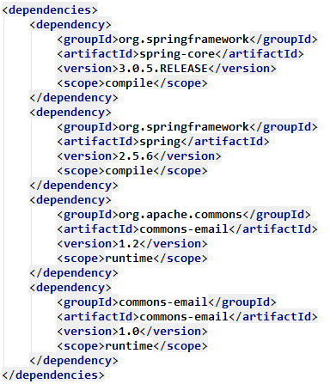
Use case – Duplicates
http://goo.gl/ZFRvp

Slide 32

https://github.com/evgeny-goldin/gmaven-samples
Duplicates Finder
http://www.flickr.com/photos/rohdesign/3534506648/ (rohdesign.com)

Slide 33
http://evgeny-goldin.com/wiki/Duplicates-finder-plugin
<plugin>
<groupId>com.goldin.plugins</groupId>
<artifactId>duplicates-finder-plugin</artifactId>
<version>0.2.3.4</version>
</plugin>

Slide 34
http://evgeny-goldin.com/wiki/Gradle-duplicates-plugin
apply plugin: 'duplicates'
...
duplicates { configurations = [ 'compile', 'runtime' ] }
...
>gradle duplicates

Slide 35
Maven Plugins
Duplicates found in:
-=-= [org.codehaus.plexus:plexus-classworlds:jar:2.2.2:compile,
classworlds:classworlds:jar:1.1:compile] =-=-
-=-= [commons-logging:commons-logging-api:jar:1.1:compile,
commons-logging:commons-logging:jar:1.1.1:compile] =-=-
-=-= [nekohtml:xercesMinimal:jar:1.9.6.2:compile,
xerces:xercesImpl:jar:2.8.1:compile] =-=-
-=-= [nekohtml:nekohtml:jar:1.9.6.2:compile,
net.sourceforge.nekohtml:nekohtml:jar:1.9.9:compile] =-=-
-=-= [commons-beanutils:commons-beanutils:jar:1.8.0:compile,
commons-collections:commons-collections:jar:3.2.1:compile] =-=-
Google Guice
Duplicates found in:
-=-= [com.google.inject:guice:jar:3.0-SNAPSHOT:compile,
com.google.inject:guice:jar:no_deps:3.0-SNAPSHOT:compile] =-=-

Slide 36
CodeNarc
Duplicates found in:
-=-= [org.codenarc:CodeNarc:0.14, org.codehaus.groovy:groovy-all:1.7.5] =-=-
--- [org.codehaus.groovy.ast.expr.RegexExpression]
--- [org.codehaus.groovy.transform.powerassert.Value]
--- [org.codehaus.groovy.transform.powerassert.ValueRecorder]
Test Compile
Duplicates found in:
-=-= [junit:junit-dep:4.8.2, junit:junit:4.8.2] =-=-
-=-= [org.hamcrest:hamcrest-core:1.2, junit:junit:4.8.2] =-=-

Slide 37
Groovy MOJOs
A Groovy class + @AnnoMojo

Slide 38
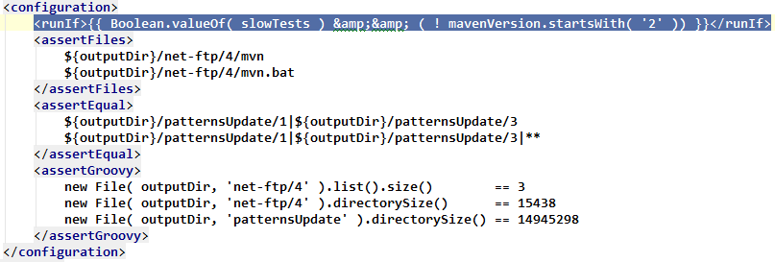
Groovy MOJOs
A Groovy class + @AnnoMojo
Dynamic properties
http://goo.gl/UqBqn

Slide 39
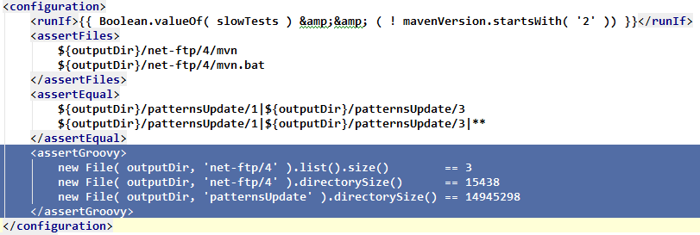
Groovy MOJOs
A Groovy class + @AnnoMojo
Dynamic properties
http://goo.gl/UqBqn

Slide 40
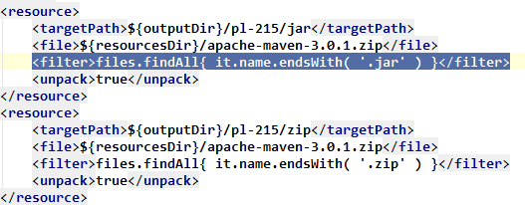
Groovy MOJOs
A Groovy class + @AnnoMojo
Dynamic properties
http://goo.gl/xV73v

Slide 41
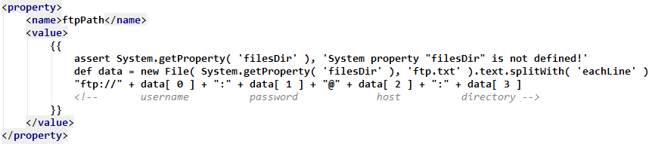
Groovy MOJOs
A Groovy class + @AnnoMojo
Dynamic properties
New Maven properties
http://goo.gl/tEgQa

Slide 42
Groovy MOJOs
Other plugins can be extended or invoked
Their initialization though, may not work well
http://github.com/TimMoore/mojo-executor
http://goo.gl/tEgQa

Slide 43
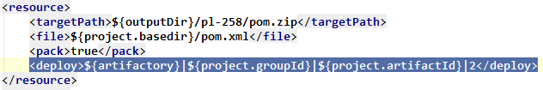
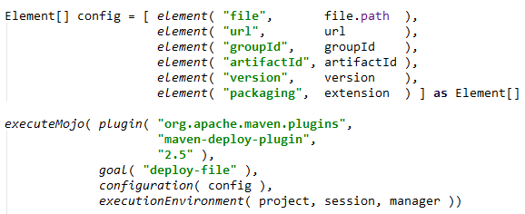
mojo-executor
http://goo.gl/CT6AQ

Slide 44
Groovy MOJOs
A Groovy class + @AnnoMojo
Dynamic properties
New Maven properties
Other plugins can be extended or invoked
That’s how you deal with Maven!

Slide 45
Maven 3 vs. Maven 2
IE9 vs. IE6
Maven 3: Aether, mojo-executor, better Mojo support
Maven 3 Mojos will not run on Maven 2
Maven 2 support will seriously hold you back

Slide 46

Groovy MOJOs
“if” a model composition / plugin execution
Specify dynamic value when configuring a plugin
Put your own logic in POM
Modify existing plugins behavior
Pass in-memory information between plugins

Slide 47
So ..

Slide 48
So ..
GMaven - custom build behavior on any phase
Polyglot Maven is a Groovy syntactic sugar
Groovy Mojos is the way to make it your way

Slide 49

So ..
GMaven - custom build behavior on any phase
Polyglot Maven is a Groovy syntactic sugar
Groovy Mojos is the way to make it your way
Creating build applications with Maven – doable!
  Maven is not a solution, but a platform

Slide 50
So ..
GMaven - custom build behavior on any phase
Polyglot Maven is a Groovy syntactic sugar
Groovy Mojos is the way to make it your way
Creating build applications with Maven – doable!
  Maven is not a solution, but a platform
  We don’t have to be limited by existing plugins
  Perl, IDEA, Jenkins, jQuery, Grails, Gradle ..

Slide 51
Maven Plugins
http://evgeny-goldin.com/wiki/Maven-plugins
maven-copy-plugin
maven-jenkins-plugin
maven-assert-plugin
maven-mail-plugin
maven-about-plugin
duplicates-finder-plugin

Slide 52
Maven Plugins
http://evgeny-goldin.com/wiki/Maven-plugins
maven-copy-plugin
maven-jenkins-plugin
maven-assert-plugin
maven-mail-plugin
maven-about-plugin
duplicates-finder-plugin

Slide 53
Gradle Plugins
http://evgeny-goldin.com/wiki/Gradle-plugins
“About” plugin
“Duplicates” plugin
“CodeNarc” plugin

Slide 54
Links
@evgeny_goldin
http://evgeny-goldin.com
http://pinboard.in/u:evgenyg/t:gmaven/
http://pinboard.in/u:evgenyg/t:mojo/
http://pinboard.in/u:evgenyg/t:maven3/

Slide 55


